Slide 1


Titan Gym Management System

Slide 2

Hello!
MGMCET
PROJECT BY :
Rutuja Shelar (Roll No : 57 )
Smruti More (Roll No : 39 )
Nisha Tapase (Roll No : 61 )

Slide 3
Table Of Content
Introduction To Project
Project Scope
Project Goal
Project Profile
Main Features
Project Objectives
Use Case Diagram For Admin
Conclusion

Slide 4


Introduction
The Online Fitness Gym is such a system which provide best platform for ease of access to the Gym Staff.
The focus of this project is about online services for a fitness club but by minimizing all those defects which are found in currently available manually file system.
This is a best platform to Store a whole lot of details of the Gym Members.

Slide 5

Project Scope
The administrator has the full-fledged rights over this System.
The admin can register and view the Customers Profile Data.
Admin will update evaluation report of customer , update diet plan , update exercises schedule , answer to questions made by customers and email automatically will be sent to customers by system.
The Admin can make announcement about any thing.
Admin have control over the huge data about the gym members.

Slide 6

Project Goal
To remove the manual or paper work in the Fitness club.
Provide a platform with interactive user interface for both customer and admin.
Save the time of both admin and customer.
Get online Plans in an efficient manner.
To save cost for each user.
User friendly

Slide 7
Project Profile
Project Title :
Organisation:
Platform: Front End:
Back End:
Logic Tools:
Operating System:
Gym Management System
MGMCET
XAMPP Server
PHP MySQL
Javascript, jquery, css
MS Window 10

Slide 8

Main Features
Gyms Management
Gym Members Management
Payment Management
Plan Management
Exercise Routine Management

Slide 9

Project Objectives
Add Newly Joined Members
Add payment areas.
Add different plan & exercise of gym.
View plan for training
View payment areas.
View members to gym.
View different info of members.
Update and delete different values of gyms, payments made, gym member’s details and plan’s information.

Slide 10

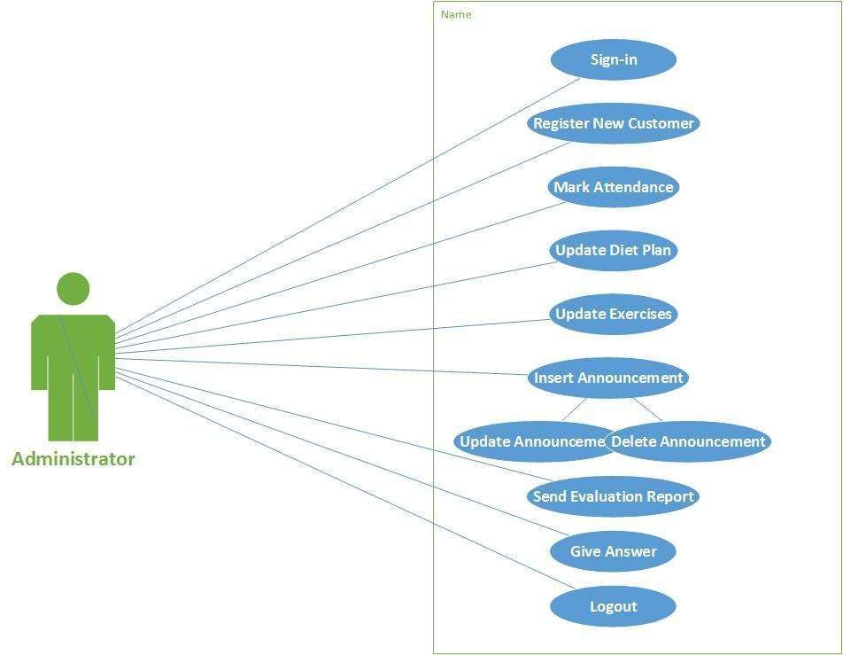

.
Use Case Diagram

Slide 11


Conclusion
The project Smart Gym System is for computerizing the work in a Gym.
The application takes care of all the requirements of a admin Department and is capable to provide easy and effective storage of information related to Department.

Slide 12
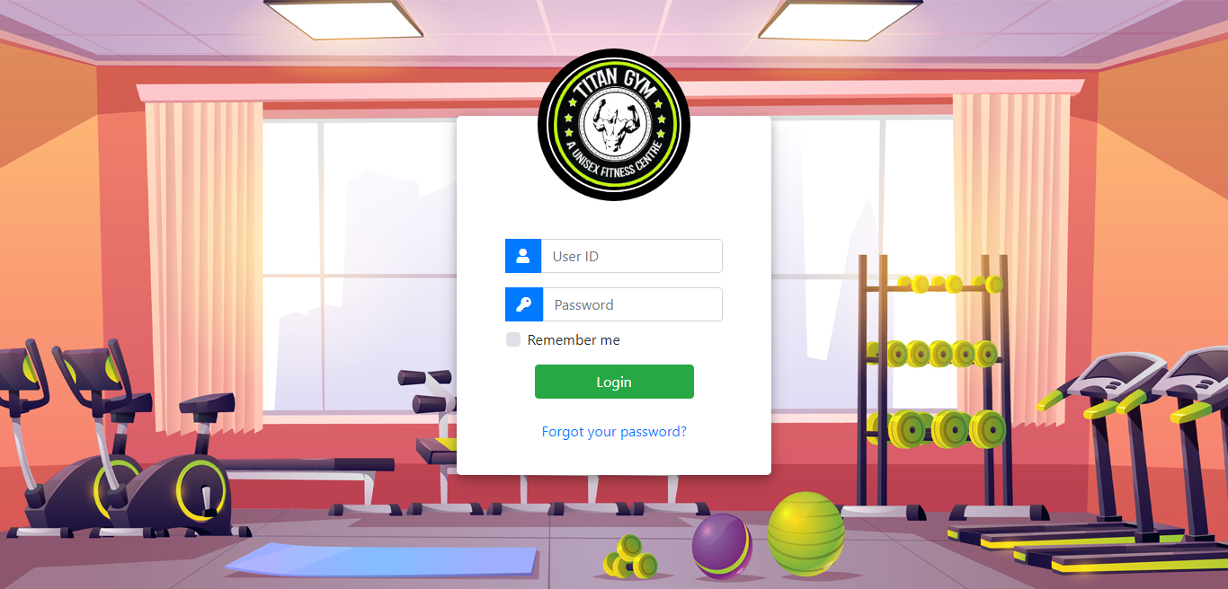
Web project
A Step
Towards Smart
&
Easy Gym Management System
Place your screenshot here

Slide 13
Thanks!

